Slide 1
HR and Finance:
A Pivotal Relationship
MARK FOGEL | JUNE 21, 2016 – JUNE 22, 2016
NY STATE Conference September 18th,2016

Slide 2
Contact Me
You can reach Mark Fogel at:
humancapital3@gmail.com
Follow Mark on:

Slide 3
About Me
Mark is a disruptor in the HR space. With 15 years heading HR at 3 prominent organizations and a slew of National Awards, including the SHRM Human Capital Leader of The Year, he has made a major impact on the Human Capital function. He is also the founder of Human Capital 3.0, an HR boutique with some very big clients. Often quoted in national media, Mark is an HR thought leader with a unique point of view.

Slide 4
What’s Your Elephant?

Slide 5
Venus & Mars – HR & Finance
Human Resources
Finance

Slide 6
Past History
Up until 1989, HR was not a term widely used
The SHRM changed its name that year from The American Society for Personnel Administration (ASPA)
HR was known as personnel or administration in the late 80’s to the early 90’s and was a sub function of Finance (just as the USA was a colony of Britain)

Slide 7
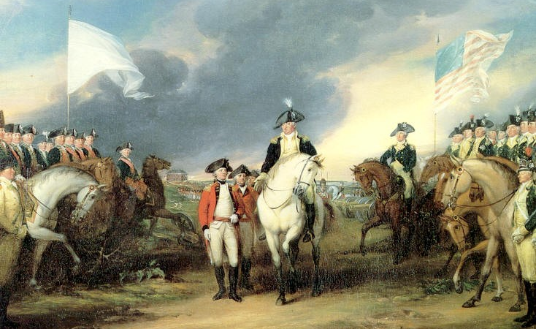
Breaking Away from Finance
HR has grown into a function no longer subservient to Finance (just as the USA broke away from Britain in the late 1700s)
HR is expected to work together with, rather than under, Finance which can cause difficulties in the relationship due to underlying resentment

Slide 8
Interdepartmental Friction
Finance deals with managing costs
HR deals with managing human capital
Biggest cost to companies

Slide 9
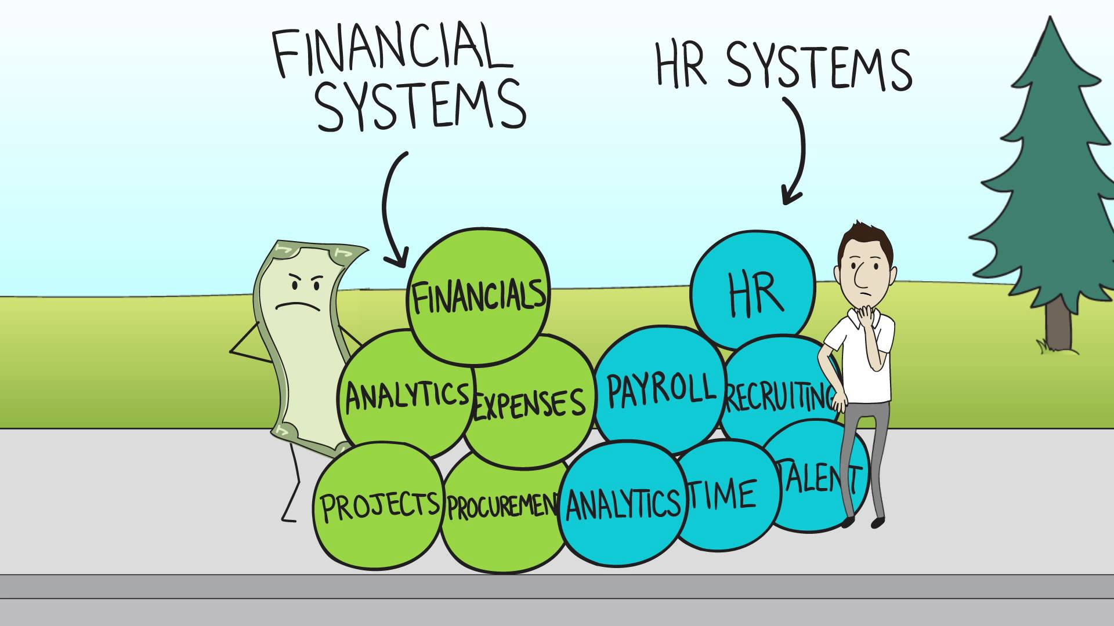
Working Together
"The drive to automate talent management also comes in part from the desire to pull together HR, Finance, and operations data to get insights on talent that are otherwise difficult to obtain"
- Mathis & Jackson

Slide 10
Point / Counterpoint
“HR doesn’t get the business or the profit model”
“Finance doesn’t understand how to get the best out of each employee”
AND…
“HR makes arbitrary decisions without data to back it”
“Finance fails to see the qualitative nature of performance”

Slide 11
A Tale of Two Cities

Slide 12
Today’s Discussion
Missions and goals
Putting organizational needs first
Software / hardware
Common data / language of business
Shared timetables and schedules
Regular meetings and communication up and down the HR/Finance function

Slide 13
Exercise #1

Slide 14
It Starts with Common Ground

Slide 15
A Common Purpose
Mission and goals alignment
Work towards the same organizational outcomes
ALL for ONE and ONE for ALL

Slide 16
Prioritizing Agendas
Organizational
Agenda
First
Personal
Agenda
Second

Slide 17
What Do You Have in Common?
“Soft”ware

Slide 18
What Do You Have in Common?
“Hard”ware

Slide 19
“It’s All in the Data”
Data is the common denominator that links HR and Finance together

Slide 20
Myopic Views
Instead of having a common ground,
HR & Finance are still playing solitaire with their reporting and language

Slide 21
Length of Time
Shared Timetable

Slide 22
Data for Today

Slide 23
A Changing World

Slide 24
Data for Tomorrow/Strategic

Slide 25
Recap
Missions and goals
Putting organizational needs first
Software / hardware
Common data / language of business
Shared timetables and schedules
Regular meetings and communication up and down the HR/Finance function

Slide 26
Key Ingredients to Effective Organizational Leadership/Partnership

Slide 27
Contact Me
You can reach Mark Fogel at:
humancapital3@gmail.com
Follow Mark on:

