Slide 1
SHRM Update
& Volunteer
Resources
NY State Leadership Conference
April 5th, 2014 – Rochester, NY
Susan Post, SPHR, CAE
Divisional Director East

Slide 2
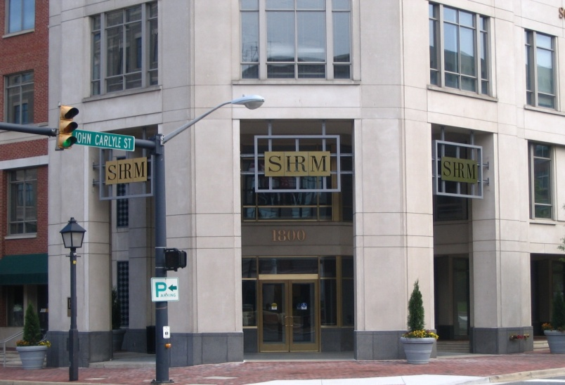
About SHRM
The parent organization
Founded in 1948
World’s largest professional association dedicated to HR
Headquartered in Alexandria, VA
About 350 staff members
About 270,000 professional
and student members in
more than 140 countries
More than 575 affiliated
local chapters
Over 6,000 volunteer leaders

Slide 3
SHRM’s Vision
SHRM will be a globally recognized authority whose voice is heard
on the most pressing people management issues of the day –
now and in the future.

Slide 4

SHRM’s Strategy
Continue to provide high-value resources to existing core membership
Be a global organization
Operate as a financially sustainable organization
Be the recognized thought leader on people management issues

Slide 5
How Are We Connected?
SHRM and Affiliates

Slide 6

Chapter Governance
An affiliate of SHRM – the parent organization
  Rules and expectations
  Chapter bylaws cannot conflict with SHRM bylaws
  Must keep bylaws up to date
  Chapter charter outlines the relationship between SHRM and chapter
Non-profit association
  Governed by federal and state laws for non-profits
  Entire board should read and know what the bylaws say
  Bylaws must accurately reflect what the board is doing
  No one person on the board makes decisions for chapters; must be by majority vote of the governing body

Slide 7
Volunteer Structure
SHRM® Board
Governance Committee*
Membership
Advisory Council
HR Expertise Networks
Ethics
Global
Labor Relations
Workplace Diversity
HR Technology
HR Disciplines – Includes:
Talent Management, Compensation, Benefits, Organizational Development, Employee Relations, Employee Health, Safety & Security
Regional
Councils
Members
State
Councils
Local
Chapters
Staff Support
Notes:
SHRM is “profession-focused, member-driven, volunteer-led, and staff-managed.”
The very structure of SHRM and the involvement of the volunteer leaders support this position.
Each of these entities plays an integral part in the success of SHRM – let’s talk about each one in more detail.

Slide 8
Chapter sizes
Small Chapter = 10 – 100 members
Medium Chapter = 101 – 300 members
Large Chapter = 301 – 500 members
Mega Chapter = 501 – 1,000 members
Super Mega Chapter = 1,000 + members

Slide 9
SHRM Requirements
SHRM bylaws require chapter presidents and all state council members be active SHRM members throughout the duration of their term.
  Must be indicated in chapter bylaws.
  SHRM encourages chapters to require all board members to be SHRM members for greater synergy in the affiliation relationship.
Effectively lead chapter or state council throughout the year and mentor president-elect for upcoming year.
Assure bylaws are being followed.
Attend and actively participate in state council meetings.

Slide 10
SHRM Requirements
New chapter affiliation requirements as of January 1, 2012:
All 100%-Chapters
  Minimum of 25 SHRM members AND
  100% SHRM membership
All Non-100% Chapters
  Minimum of 25 SHRM members AND
  Minimum of 51% SHRM membership
Applies to all existing and new chapters - no grandfathering.
Chapters not currently meeting new affiliation requirements will have a five year period (by 12/31/2016) to do so.
Regional Team is working with under-affiliated chapters to ensure successful transition to new requirements (Fortune Forty Team).

Slide 11
Chapter Charters
Every chapter has one
These documents spell out the relationship between SHRM and chapters
  Who owns membership lists
  Correct use of the SHRM logo
  Correct use of the SHRM name
  (don’t call your chapter or council SHRM)
Be sure your chapter has a copy; review it annually
If your copy is lost, contact your Regional Administrator

Slide 12
Bylaws
All board members should carefully review the bylaws upon taking office and should follow them as a legally binding document
Bylaws model online – be sure your bylaws include all required sections as stated in the checklist online
ANY bylaws revisions need to be sent to your Field Services Director (FSD) for review
Two sets: original bylaws showing markups/changes and clean, final set for signature
ANY bylaws changes will then be approved by SHRM (including name changes and changes to 100%)
Do not plan your chapter membership vote until AFTER you have received the signed final copy from SHRM

Slide 13
Use of the SHRM Affiliate Logo
Must be used correctly at all times
Graphics Standards Manual for Affiliates
New Sections added
  Chapter and State Council Award Logos
  Membership Star and Superstar Award Logos
  100 Percent Chapter and State Council Logos
  Chapter and State Council Logos

Slide 14


Which is correct?
Check your entire website, all documents, etc.

Slide 15

SHRM Affiliate Logo
Appropriate Use
Place prominently on all materials produced by an affiliate of SHRM.
Do not modify the logo; must be the entire “Affiliate of” logo, and never be smaller than 1-inch wide.
Use in conjunction with your chapter logo –- same size and near each other
Place it “above the fold” on website
If SHRM is part of your chapter name, your chapter logos must be approved by SHRM

Slide 16
Chapter Leader Information Form (CLIF)
Due December 1 for chapters operating on a calendar year
Online form for your chapter to submit complete board/volunteer roster
Due by 12/1, even if you don’t have all roles filled by then
  For chapters whose officers transition mid-year, the deadline is the 15th of the month prior to when the new officers term begins
  E.G. Chapter Officers’ terms begin 7/1, CLIF is due 6/15
List those roles you know, and provide remaining volunteer list later
Required for all chapters
Allows SHRM to keep in touch with your board members to announce new tools, webcasts, etc.
Must submit on time to qualify for any award for the year

Slide 17
Expectations of Volunteers
Chapter Presidents should attend all state council meetings or send substitute/proxy
Please READ all correspondence from your State Council, District Directors, and from your Regional Team
Please ask your company to allow e-mail messages from SHRM, your Regional Team and council members
If you ever opted out of any SHRM e-mails, you will not receive volunteer e-mails until you opt in again
E-mails from SHRM Volunteer Communications and the monthly SHRM Update are our MAIN point of communication with you – please read them

Slide 18
Role of District Directors
Assist chapter presidents with questions
Visit chapters to provide presentation on “SHRM is the Solution” to your members
Ensure that chapter presidents attend state council meetings
Ensure that chapters submit SHAPE on time
Your District Director and State Council Director should be your first volunteer point of contact for assistance
For CLA issues/questions, the state CLA leaders should be your points of contact

Slide 19


SHRM Volunteer Tools & Resources

Slide 20
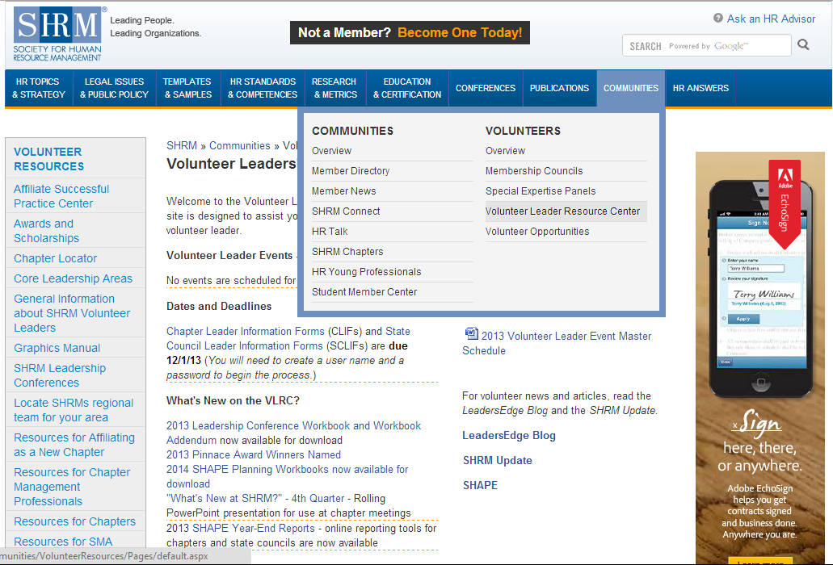
Volunteer Leader Resource Center (VLRC)
www.shrm.org/vlrc

Slide 21
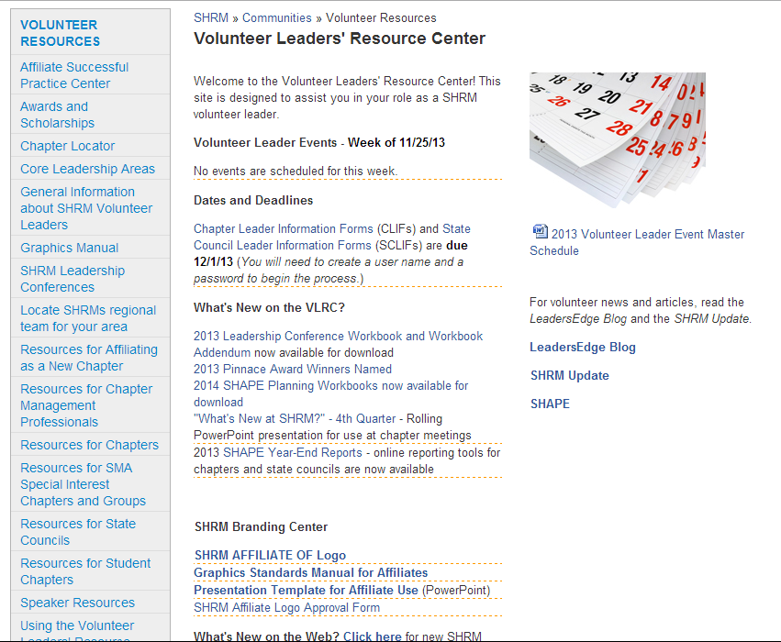
Volunteer Leader Resource Center (VLRC)
www.shrm.org/vlrc

Slide 22
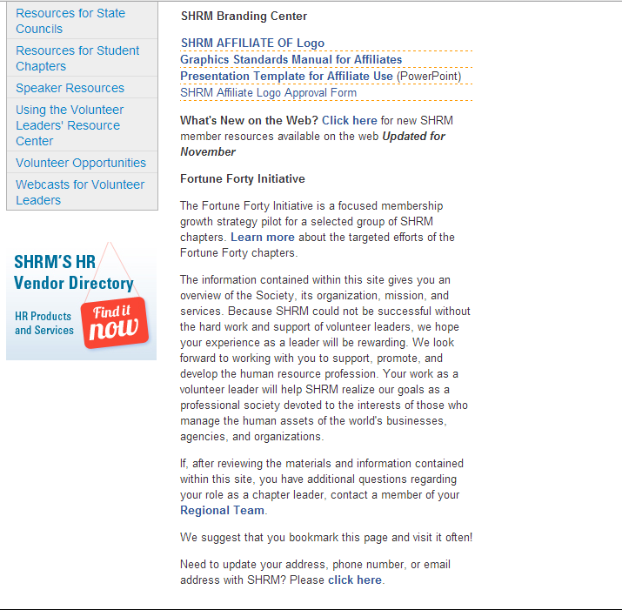
Volunteer Leader Resource Center (VLRC)
www.shrm.org/vlrc
Fortune Forty is a group of chapters under 25 SHRM members and under 51% affiliation

Slide 23
Special Sections of the VLRC
Affiliate Successful Practices Center
  Contains great ideas from other affiliates on Leadership | Operations | Workforce Readiness | Veterans/Military | SHAPE Idea Center | Enterprising Leadership Book
Awards and Scholarships
  Contains Pinnacle Award Compendium (get great ideas!) and webinars about the winning programs
Speaker Information
  Contains lists of speakers for your events: All Recommended Speakers from recent SHRM Conferences, Top Rated speakers from SHRM Annual Conferences, Keynote Speakers from SHRM Conferences, and Chapter Speaker Program

Slide 24
Special Sections of the VLRC
Webcasts for Volunteers
Archived webcasts available any time on many topics
Operations/Volunteer Leadership | Core Leadership Areas | College Relations | Diversity & Inclusion | HR Certification Institute Certification | Government Affairs | Membership |
SHRM Foundation | Workforce Readiness
Recent webcasts include:
  Engaging and Motivating Volunteers
  Succession Planning
  Successful Programming
  Transitioning to a 100% Chapter
  Leveraging Technology (I & II)
  Working with the Media
  Conference/Event Planning
  Financial Management and Legal Issues for Chapters
  Dealing with Difficult Volunteers

Slide 25
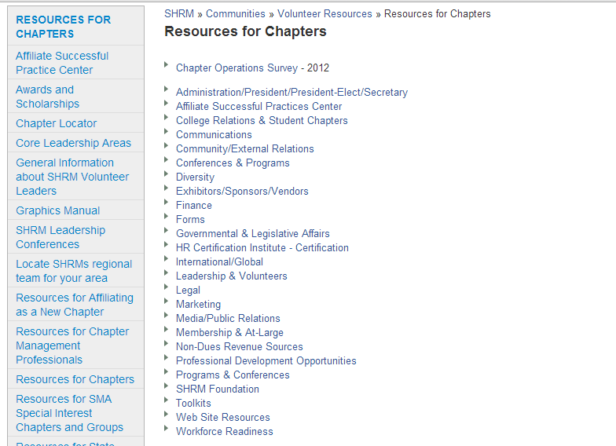
VLRC: Resources for Chapters
Survey data from chapters about dues, programs, etc.
Resources for every volunteer role – don’t reinvent the wheel!

Slide 26
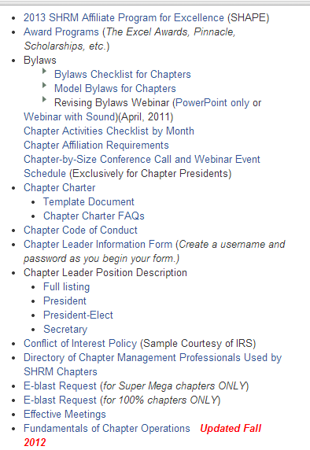
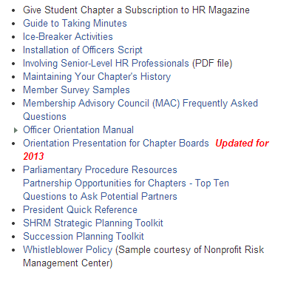
VLRC: Administration/President/President-Elect/Secretary
Resources for Chapters

Slide 27

Position Descriptions
Use as a guide for volunteer leader positions in your chapter
Easier to hold volunteers accountable if you have a written description of role & responsibilities
Sample descriptions available online
List amount of time each role will require
Consider giving each volunteer the position
description and after they review it, they can
sign off stating that they understand the
requirements

Slide 28
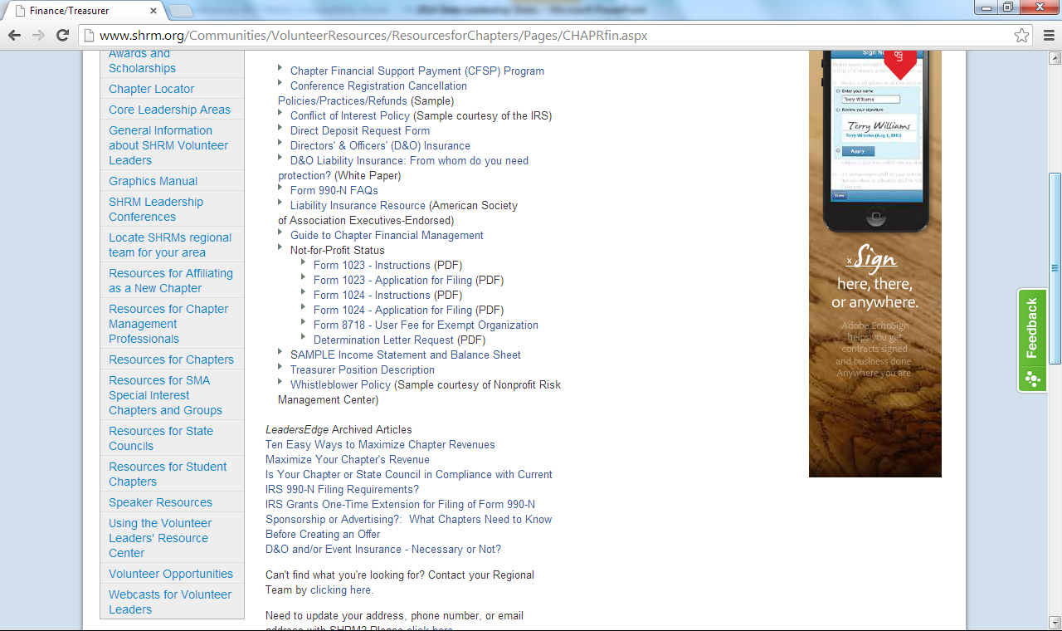
VLRC: Finance/Treasurer
Resources for Chapters

Slide 29
Core Leadership Areas
Each state council is asked to have the following positions:
  College Relations
  Diversity
  Governmental Affairs
  HR Certification Institute Certification
  Membership
  SHRM Foundation
  Workforce Readiness
Chapters should consider these board roles as well

Slide 30
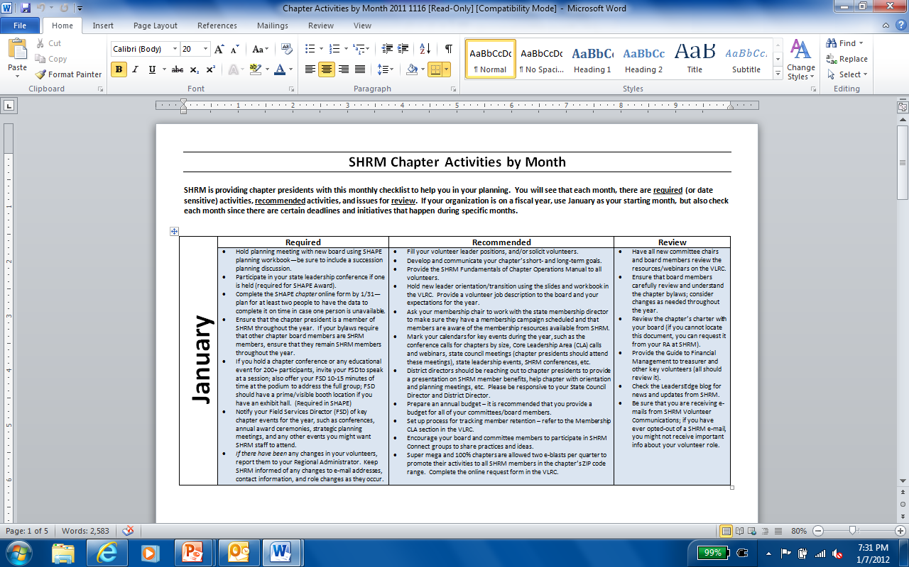
VLRC: Chapter Activities Checklist by Month
Under Administration/President . . .

Slide 31

VLRC: Chapter Leader Resource Guide
Under Administration/President . . .
All volunteers on your board should have a copy and review it carefully
Contains info on: Staff contacts, governance and bylaws, incorporation, membership rosters, affiliation requirements, using e-blasts, chapter operations, and much more
Download from VLRC at www.shrm.org/Communities/VolunteerResources/ResourcesforChapters/Documents/Fundamentals_of_Chapter_Operations_12-0642.pdf

Slide 32
VLRC: Guide to Chapter Financial Management
Under Finance/Treasurer
All chapter officers should review this guide
Operating Considerations
Methods of Accounting and Financial Reporting
Checklist of Internal Controls Over a Chapter’s Cash Transactions
Auditing
Financial Maintenance Questionnaire
Investments
Tax Filings
Unrelated Business Income
Lobbying Activities
Travel and Meal Reimbursement
Record Retention Guidelines
Appendix–Financial Maintenance Questionnaire

Slide 33

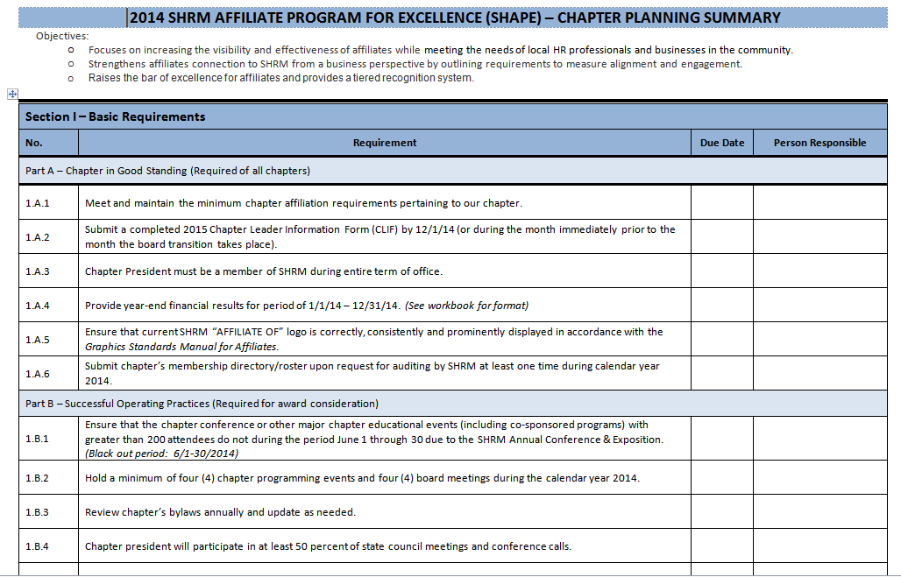
SHRM Affiliate Program for Excellence
SHAPE
Both a planning tool and an evaluation tool
Covers calendar year
Reporting tool for SHAPE award
Must be filed with SHRM by 1/31 to receive CFSP
Need to determine now who will complete
Complete online only
2014 Planning book and worksheet available

Slide 34
SHAPE
Sections and Awards
Section 1: Basic Requirements (Must be completed by ALL chapters to remain affiliated)
Section 2: Community-Based Chapter Initiatives
Section 3: SHRM Affiliate Engagement
Section 4: Measures of Success
Appendix A: Resources
Appendix B: Sample Year-End Report Form
Four award levels: Bronze, Silver, Gold, and Platinum
You must have submitted your CLIF by December 1st (or by the 15th of the month prior to the effective date of mid-year officer transitions) to qualify for any SHAPE award

Slide 35


Membership Award Status
1% - 3.99%
STAR
4% or more
SUPERSTAR

Slide 36
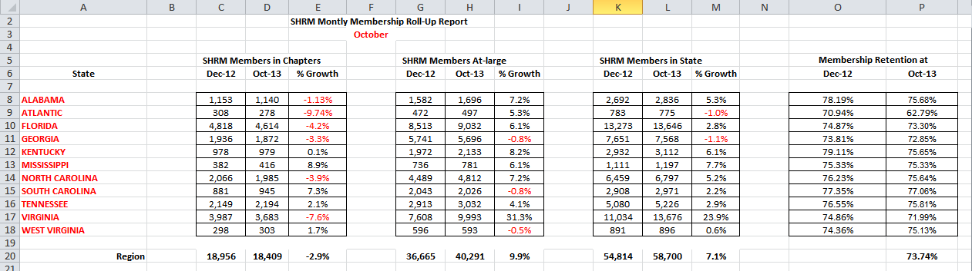
Monthly Membership Reports
Sent to State Council Directors, State Council Membership Directors, Chapter Presidents & CMPs
Report shows SHRM members in chapters, at-large in state, SHRM members in state, and retention rate in state. Note the red numbers indicate negative numbers, or member losses. Note also the retention rate. SHRM’s goal is for each state to meet at least an 80% retention rate. Several years ago, most states were at an 80%+ rate.

Slide 37
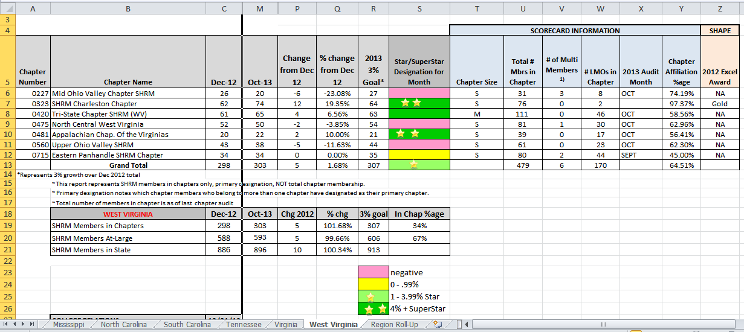
Monthly Membership Reports
Sent to State Council Directors, State Council Membership Directors, Chapter Presidents & CMPs
At the bottom of the report are tabs for each state in the region. Compare year-end numbers with current month. Also note member growth/loss and percent change. PLEASE NOTE that LMO numbers are captured only ONCE per year, during the audit. LMO numbers on this report will NOT CHANGE.

Slide 38
Membership Reports from SHRM
Chapters can request . . .
SHRM monthly or quarterly reports via an e-mail request with a set deadline
  Current chapter roster
  Full at-large list within chapter’s established zip code range
  Expired SHRM members in the chapter
  New at-large members list within the quarter
The roster requests will be distributed within 48 hours
SHRM will also provide sample e-mails/letters that the chapter can use for their benefit
These reports are NOT sent automatically, but can be requested
Membership chair should conduct at least quarterly audits comparing the SHRM at-large list, the SHRM in-chapter list, and the chapter’s roster. Send the RA any discrepancies.
Send list of your new/expired members
to SHRM each month

Slide 39

Conducting Membership Audits
SHRM uses the member roster sent by your chapter to conduct audits on an annual basis
Please send chapter membership roster upon request—the more current, the more accurate the audit
Please note that SHRM conducts only ONE audit per chapter per year.
Other audits can be conducted by volunteers and changes shared with SHRM throughout the year.

Slide 40
Primary Designation Forms
Primary Chapter Designation Form submission deadline – NEW!
  From January – November, CDFs must be received by the 5th business day prior to the end of the month to be processed.
  For December, must be received by December 15th to be processed by the end of the year.
While a SHRM member may belong to more than one affiliated chapter, only one chapter may be designated as that member's primary chapter. The member is free to change that designation as he/she wishes. Primary Chapter Designation Forms are signed directives from the member to SHRM authorizing SHRM to change his/her primary chapter designation.
The form is completed by the member and faxed or emailed to SHRM. Upon receipt of the executed form, the member's primary chapter will be changed. To ensure changes are made during the appropriate month, submission deadlines are in place.

Slide 41
In-Transition Membership
Please share with your members
SHRM offers a one-time-only benefit of a free one-year continuation of membership to any current member who has been downsized
Must already be a member of SHRM
Contact SHRM’s Member Care Department for more information
Consider offering this option to your own members – great for retention!

Slide 42
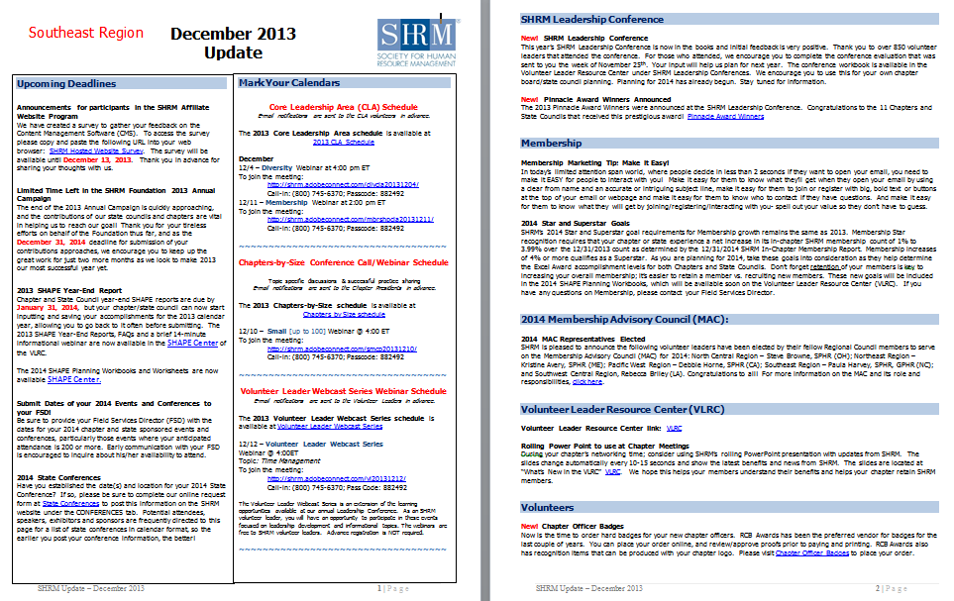
SHRM Monthly Update
Watch for this report to come each month from your SCD. Look for conference call & webinar dates, upcoming deadlines, important volunteer news from SHRM, upcoming events and conferences, new SHRM-member benefits, and contact information.
Read each month!

Slide 43
E-Blasts
Use them!
SHRM offers State Councils, Super Mega chapters, and 100% chapters the opportunity to reach at-large members via e-mail eight times per year (two per quarter)
Use online request form in the VLRC
SHRM sends the e-blast on your behalf and will make edits as necessary
State Councils also receive e-blasts for announcing the state conference to members in their own state

Slide 44

Chapter Financial Support Payments (CFSP)
The CFSP Program returns a portion of each SHRM member’s dues to the chapter through this program.
To be eligible for CFSP consideration, the chapter must:
  Submit a completed SHAPE Year-End Report by 1/31 of each year and your membership roster when requested
  Meet the applicable membership affiliation requirements.
  Have a chapter president who is a SHRM member in good standing throughout his/her term of office.
  Have SHRM-approved ratified bylaws on file at SHRM.
  Have the payment direct-deposited.

Slide 45
Chapter Financial Support Payments (CFSP)
SHRM pays chapters and councils several million per year in financial support
Pays each state council between $3000-7000 per year based on SHRM membership in state
The Chapter Financial Support Payment (CFSP) Program returns a portion of each professional (non-student) SHRM national member's dues to the chapter via a quarterly payment for 100% chapters (those chapters who require all members to be members in good standing of SHRM) or a twice-a-year payment for non-100% chapters.

Slide 46
Chapter Financial Support Payments (CFSP)
Example:
Chapter’s
12/31 SHRM
Membership Count
2013 250
2012 -200
Difference 50
Net Gain Payment (50 X $25) = $1,250

Slide 47

SHRM Pinnacle Award
Awarded to chapters and state councils at Annual Leadership Conference
Examples:
  Assisting community members with welfare to work
  Improving community diversity or work/family issues
  Teaching job-search skills to the unemployed
  Impacting local, state, or federal legislation
  Corporate sustainability
  Not limited to these!
$1,000 award and recognition in SHRM publications
See what other volunteers have done in the Pinnacle Compendium in the VLRC

Slide 48
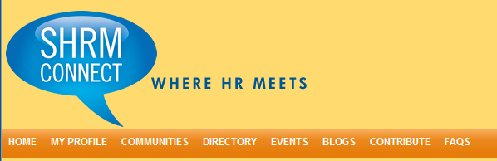
SHRM Connect
Where HR Meets!
Create a robust, online social networking platform enabling self-forming communities of interest. Create a group for your chapter.
All geographical or physical constraints are eliminated.
Create a profile for your chapter! Look at job postings!

Slide 49
SHRM Volunteer Leaders Summit
November 20th – 22nd, 2014 (Washington, DC)
Target audience is the incoming chapter presidents and incoming state directors
EVERY chapter should be represented EVERY year
FREE for incoming chapter presidents; includes hotel, designated meals and conference registration; chapter pays travel expenses
If the incoming president cannot attend, the president-elect for the next year may attend in his/her place
Attendance is tied to SHAPE award levels
Short recorded webinar for you to review AND the workbooks are online in the VLRC for download for your board at www.shrm.org/Communities/VolunteerResources/Pages/
LeadershipConference.aspx

Slide 50
Important Dates & Deadlines
Mark Your Calendars!
November 20th – 22nd 2014 (Washington, DC)
SHRM Leaders Summit
December 1st
CLIF & SCLIF due
December 31st
Deadline for receipt of SHRM Foundation donation for 2014
January 31st
Chapter SHAPE Year-End Report due
January 31st
State Council SHAPE Year-End Report due

Slide 51
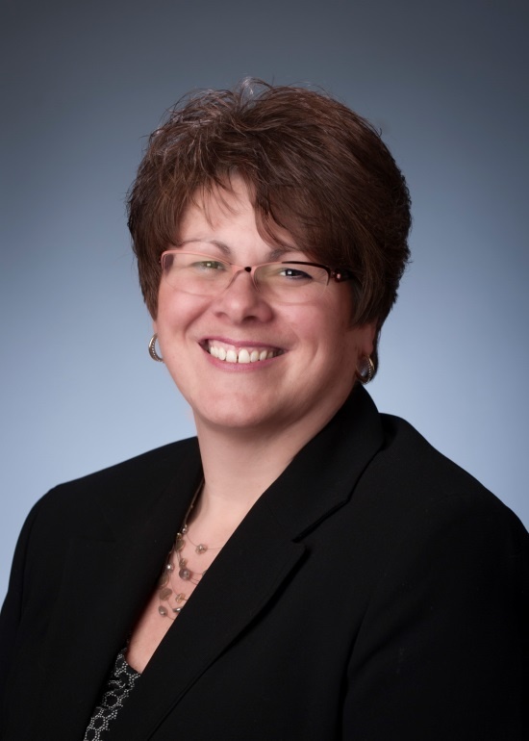
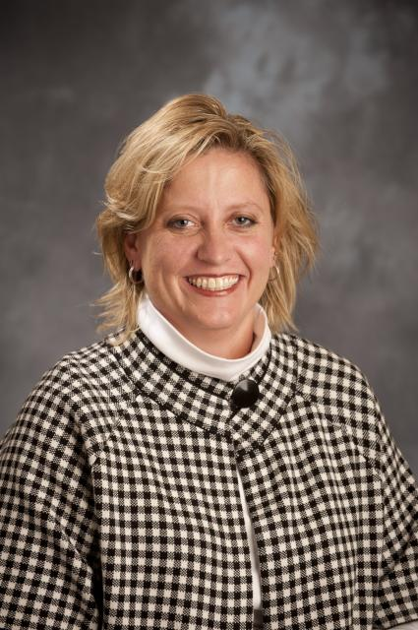
SHRM Staff Support
Susan Post, SPHR, CAE
susan.post@shrm.org
(800) 283-7476, x 6021
703-535-6201 (direct)
Tammy Finnell, CMP
tammy.finnell@shrm.org
(800) 283-7476, x 6109
703-535-6109 (direct)
Notes:
And, serving as your emcee for the conference is …………

Slide 52
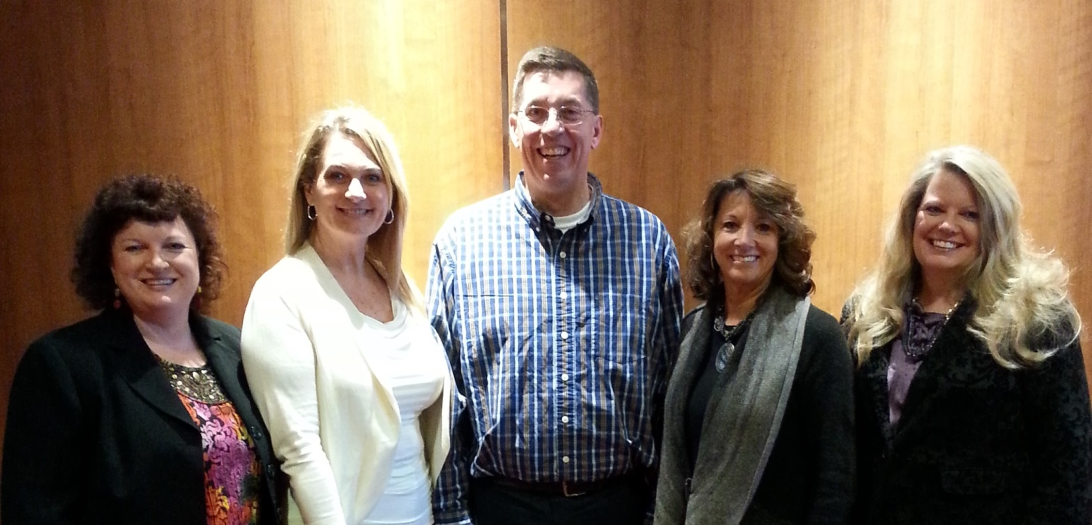
2014 Membership Advisory Council
Southeast Region: Paula Harvey, SPHR, GPHR
Southwest Central Region: Rebecca Briley
North Central Region: Steve Browne, SPHR
Pacific West Region: Debbie Horne, SPHR
Northeast Region: Kristine Avery, SPHR
Email: kavery@sjcme.edu

Slide 53
Volunteer Assistance
There are four administrators at headquarters with a general number to call: (800) 283-SHRM x 3333; 7 a.m.-7 p.m. ET. Anyone at that number can assist you with CFSP, rosters, designation forms, etc.
The number will take voicemails 24/7 but will only be manned from 7 a.m.-7 p.m. ET.
E-mail: SHRM.MemberRelations@shrm.org.
This is a generic e-mail inbox that will be accessible by all the Regional Administrators.
Order SHRM supplies from your Regional Administrator.

Slide 54
THANK YOU for volunteering
You keep SHRM successful
We grow because of YOU!

Slide 55
Questions
and
Discussion

