Slide 1
SHRM September 2016 Get Ready for your DOL Audit!
August 2016 2016
Lisa C. Allen, CHRS, CAS, CFC
Vice President, Regulatory Affairs

Slide 2
Agenda
What is happening in NYS YIKES!
ACA “old” Mandates
5500's - An ERISA Plan Necessity: Are you Filing Correctly?
Welcome to Plan Documents 101
Benefit Plan Compliance: Would Your Plans Survive An Agency Audit?
Questions
Be sure to ask questions!

Slide 3
NYS Breaking News
October 2015 The NYS Attorney General and the US Department of Labor (DOL) have reached an agreement to work together to uncover violations under ERISA and New York State laws applicable to employer health benefit plans.
What’s happening in your State?
Are you next?

Slide 4
1094-C Breaking News
Employer must report the # of employees for themselves and any Control Group affiliates.
IRS will take that information and look for a filed IRS Form 5500 for any employer with 100 or more employees.
No 5500 found, here comes your letter!
Another tool to catch you!

Slide 5
ACA “old” Mandates. Do you have proof?

Slide 6
Impact on Employers/Plan Sponsors – Mandates in 2013
Form W-2 reporting requirement (for the 2012 tax year)
$2,500 limit on employee contributions to health FSAs (for plan years beginning in 2013)
Summary of Benefits and Coverage requirements (for open enrollment periods starting on or after September 23, 2012)
Special Enrollment Rights and Annual Notice for Dependents to 26 coverage

Slide 7
Impact on Employers/Plan Sponsors – Mandates in 2013
Requirement for employers to notify employees of the availability of health insurance exchanges (March 2013)
Expansion of FICA in 2013 to include an additional 3.8% tax on the unearned income of high income individuals
0.9% Medicare payroll tax increase in 2013 on high income individuals

Slide 8
Impact on Employers/Plan Sponsors – Mandates in 2014
Reinsurance contribution to collect 12 billion in 2014
The “pay-or-play” mandate
Employer certification to HHS regarding whether its group health plan provides “minimum essential coverage”
Increase in permitted wellness incentives from 20% to 30%
Exchange Notices

Slide 9
Impact on Employers/Plan Sponsors – Mandates in 2014
For large employers (200+ employees), automatic enrollment of new employees in a group health plan (REPEALED)
90 day limit of waiting periods
Coverage under non-grandfathered plans for certain approved clinical trials
Complete prohibition on annual dollar limits
Guaranteed availability and renewability of insured group health plans
Prohibition on preexisting condition exclusions

Slide 10
5500's - An ERISA Plan Necessity
Are you Filing Correctly?

Slide 11
What is ERISA?
The Employee Retirement Income Security Act of 1974 (ERISA) (Pub. L. 93-406 codified as 29 USCS § 1002)
A federal law that was enacted on 9/2/74 that sets minimum standards for most voluntarily established pension and health plans in private industry to provide protection for individuals in these plans.
ERISA does not require that an employer provide benefit plans, such as health insurance, to its employees or retirees, but it regulates the operation of a health benefit plan if an employer chooses to establish one

Slide 12
Federal Breaking News
July 2016
Proposed Regulations Released
To amend the Form 5500 for the first time in many, many years.
*New Schedule J
*New requirements to file for employers under 100 participants
*Self reporting of compliance with ACA
* Self-funded plans are in for more and more documentation, proof, and data reporting
Here come the audits!!

Slide 13
What’s a Schedule J?
This new schedule requires reporting information such as
Plan Design
Categories of benefits provided
Is the plan an HDHP
Include an HRA or FSA
Is the plan grandfathered
Number of individuals offered coverage & how many elected COBRA
Claims payment policies and practices
Enrollment data
Financial disclosures, denied claims and cost sharing
Identification of service providers (TPA, PBM, Wellness Program Managers

Slide 14
What’s a Schedule J?
The Schedule will include compliance questions such as:
Is the SPD in compliance
Is the SBC in compliance
Is the coverage provided in compliance with applicable federal laws, DOL regulations including, among other,
HIPPA
GINA
MHPAEA
ACA

Slide 15
What does it mean?
Schedule J alone is estimated to affect 3.3 million group health plans
Increase Form 5500 filing costs by $203 million
Increase burden/time/cost to comply 2.2 million hours or $242 million
Who will be your subject matter expert and complete the new reporting requirements? Vendor, Broker, TPA, In-House, Attorney?

Slide 16
ERISA/Welfare Benefit Plan(s):
Fully insured, self-insured or a combination of both, including:
Health Group Term Life
Dental Group Long Term Disability
Vision Group Short Term Disability
Supplemental Life Travel/Accident
Flexible Spending Accounts Health Reimbursement Arrangements
Employee Assistance Program
(not NYS DBL, this is State mandated)

Slide 17
“Unintentional” ERISA plans
Some voluntary benefits may be an “unintentional” ERISA plan if written on the group framework
i.e. - Voluntary short term i.e. - Voluntary long term disability
Other voluntary benefits may not be if:
Written with individual policy numbers per employee
Employer only collects after tax deductions, submit to carrier
Review your plans carefully—when in doubt, seek benefits counsel

Slide 18
Definitions & Requirements

Slide 19
Who has to file?
All Welfare Benefit Plans
Covered by ERISA
With 100+ participants as of beginning of plan year
Multiple Employer Welfare Arrangement (MEWA) as defined in ERISA section 3(40) must file
Government Entities exempt, as well as some Public Authorities (depending on funding stream)

Slide 21
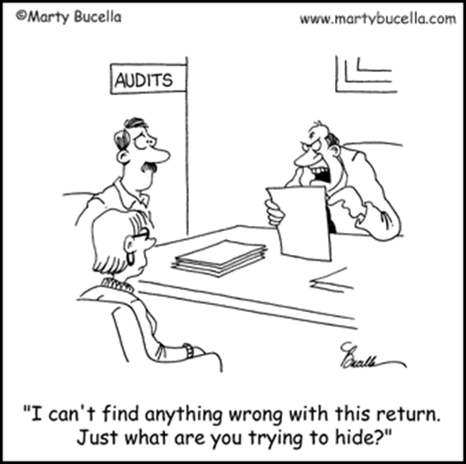
I need to file, now what?
Who completes the 5500?
Internal Staff?
Broker?
TPA?
Using Efast? Private Vendor?

Slide 22
What if I should have filed but never did?
The DOL has authority under ERISA section 502(c)(2) to assess civil penalties
Up to $1,100 per day
Maximum $30,000 per year
Against plan administrators who fail or refuse to file Form 5500 annual reports on a timely basis

Slide 23
Let’s talk Penalties!
Per day: $1100 (up to 27 days)
Per year: $30,000 (more than 27 days)
Maximum Penalty: $30,000 per year - no limit
REALLY!?!
If you don’t use a “Wrap” SPD then penalty is per plan #.
# of late filings x $30,000 x # of years that weren’t filed!!!!
Penalties increased in July for an August 1, 2016 effective date and will be increased annually by January 15th

Slide 24
Plan Types

Slide 25
What’s up with my EAP?
If it is determined that your EAP is a Welfare Benefit Plan… everything we have discussed so far…
DITTO!
DOL will not come right out and say your plan is or is not a Welfare Benefit Plan within the meaning of Section 3(1), but they have provided opinions.

Slide 26
EAP Opinions
Consistently the view of DOL is that benefits for treatment of following constitute “medical” benefits or “benefits in the event of sickness” within the meaning of Section 3(1)
Drug and alcohol abuse
Stress
Anxiety
Depression
Similar health and medical problems
“Signification Medical Treatment” is not defined

Slide 27
EAP Opinions
If your EAP is a referral only program, review Opinion No. 91-26A
If your EAP provides counseling or face to face visit(s), review Opinions 88-04A & 83035A
EAP may be an ERISA plan, so plan documents, SPD, 5500’s would be required but it may be an “excepted” benefit.
If an excepted benefit where COBRA would not be applicable, if not your need to offer COBRA!
AND Initial COBRA Notices to New Hires!

Slide 28
Documents

Slide 29
What is a Summary Annual Report (SAR)?
Summary Annual Report derived from information entered on both Form 5500 and all Schedule A’s
Summary Annual Report must be provided to all benefit eligible employees within 2 ½ months from the 5500 filing deadline. For calendar year plans, this would be October 15th.

Slide 30
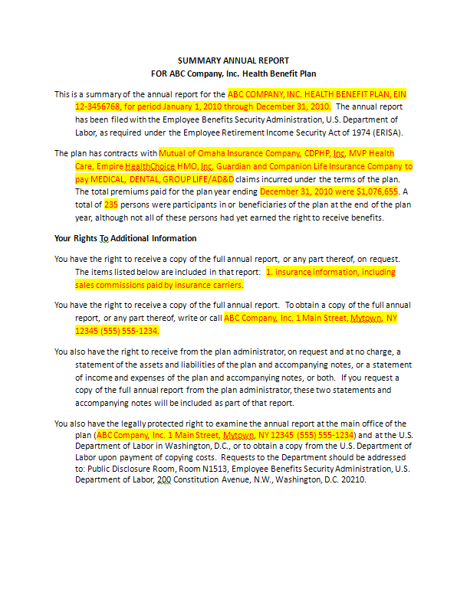
Summary Annual Report Example

Slide 31
Delinquent Filer Program

Slide 32
HELP!!!
If the IRS/DOL has not already caught you…
Take advantage of the DFVC – Delinquent Filer Voluntary Compliance Program – to reduce penalties
Reduced penalties ($10 per day)
Reduce cost of getting current with reporting obligations
Only available if plan administrator or sponsor has not received notification from the DOL of its intent to propose a penalty for its failure to file a Form 5500

Slide 33
Single filing penalty cap $2,000
For a single late filing, the cumulative penalty is capped at $2,000.
DOL added cap for plans delinquent for more than 1 year. Maximum penalty assessed under the DFVC is a "per plan" cap of $4,000.
Reduced Penalties:
Per Day: $10
Per Year: $2000
Multiple Years: $4000

Slide 34
Wouldn’t it be nice…?

Slide 35
Welcome to Plan Documents 101

Slide 36
Review the following Plan Types
Section 125 cafeteria plans (including premium only plans (POP); Health Care FSA; and Dependent Care FSA
Self-funded medical plans including active and retiree plans
Health Reimbursement Account (HRA)
Health Savings Account (HSA)

Slide 37
Review the following Plan Types
Dental plans
Vision plans
Wrap plans for fully insured arrangements (used to fill in gaps commonly left by insurance certificates of coverage)
Adoption assistance plans
Transportation/Commuter plans
Wellness plans
Employee assistance plans (EAP)

Slide 38
If it is an ERISA Plan…
If you (and your benefits counsel) determine the Plan to be a Welfare Benefit Plan, ERISA requires plans to:
provide participants with plan information including important information about plan features and funding;
enforce fiduciary responsibilities for those who manage and control plan assets;
establish a grievance and appeals process for participants to get benefits from their plans;

Slide 39
Plan Documents
What are they?

Slide 40
Plan Documents
ERISA Title I: Protects Employees’ Rights to their Benefits
Plan documents outline their rights and the plan benefits
Gives participants the right to sue for benefits and breaches of fiduciary duty and tells them how to do it!

Slide 41
“Let Me See That . . . “

Slide 42
A Plan Document Should Include:
What benefits are offered
Who is eligible for those benefits
Who pays for the benefits and how
How do you elect the benefits
How you can change the elections for those benefits

Slide 43
What do you do with them?
The Plan Document must be “adopted” by the Plan Administrator/Employer
The Plan Document must be the final authority on the Plan
IMPORTANT
There is no “Plan” without the documentation
No POP Plan, No Pre-Tax Deductions

Slide 44
Establishment of a Plan includes:
Creating, reviewing, adopting and keeping up to date the following documents:
Plan Document (Comprehensive)
Summary Plan Description (SPD)
Summary Material Modification (SMM)
Summary Annual Reports (SARs)
Summary of Benefits and Coverage (SBC) and Glossary of Terms
Summary of Material Reduction in Covered Services or Benefits

Slide 45
Plan Document
One of the most important documents
It is the comprehensive gathering of all of the rules of the Plan
It may or may not be combined with the Summary Plan Description (SPD)
A fully insured plan may receive a contract from the insurance carrier, however in this instance an SPD is still required

Slide 46
Summary Plan Description (SPD)
An important document, that the Plan Administrator is legally obligated to provide automatically and free of charge:
To employees/dependents “participants” of an ERISA benefit plan,
If a plan is changed, participants must be informed, either through a revised SPD, or in a separate document, called a Summary of Material Modification (SMM).
SPD required every 5 years (SMM every year) unless substantial amendment is required

Slide 47
SPD Walkthrough
Eligibility – information on when an employee can begin to participate in the plan; when participation is terminated
Election rules – open enrollment; change is status/other qualifying events
Benefits – services and benefits; salary reductions; funding method; premium payment
COBRA – full description of the when, how and why’s
Claims – If FSA, internal and new external appeals process
Plan Sponsor/Plan Administrator – That’s you, not the TPA
Mandatory Notices – Special Enrollment Notice, Women’s Rights, HIPAA, Patient Protection, HRA Waiver, HiTech Act, Privacy Separation and many, many more

Slide 48
What plans are included in an SPD?
Each Welfare Benefit Plan needs an SPD, however if you have a health, dental, vision, group life, group disability plan, travel/accident plan…
You can also use a “Wrap” SPD to wrap all benefits into one SPD, with one plan number, and only one form 5500 to file!

Slide 49
Summary of Material Modification (SMM)
If a plan is changed, participants must be informed, either through a revised summary plan description, or in a separate document, called a summary of material modifications, which also must be given to participants free of charge.

Slide 50
Summary of Benefits & Coverage (SBC) & Glossary
A new requirement required by the Affordable Care Act (ACA) which applies to Grandfathered and Non-grandfathered plans
Provide the Model SBC and Uniform Glossary as it applies to each plan
See: Templates and Compliance Guides
Department of Labor’s website under “Summary of Benefits and Coverage and Uniform Glossary” at: http://www.dol.gov/ebsa/consumer_info_health.html
There is also a 60-day advanced notice requirement when a health plan or issuer modifies the terms of the plan or coverage
(Penalty up to a $1,000 fine per enrollee for each failure to provide)
Employees residing in NY, Bronx and Queens County must provide Spanish SBC and Glossary . What does your State require?

Slide 51
SBC Must Be Provided
With any written enrollment application materials the plan provides (or no later than the first date the participant is eligible to enroll himself or any beneficiary in coverage)
Initial full distribution to ALL employees was during the open enrollment that begins after 9/23/12 – Do you have proof?
No later than the first day of coverage under the plan, if any changes are made to the information in the SBC provided upon enrollment
To individuals entitled to special enrollment under the Internal Revenue Code, no later than the 90 days from enrollment
Upon renewal, if applicable
Upon request (within seven (7) business days following the request)
Upon material modification (during plan year, as defined under ERISA)

Slide 52
Penalties

Slide 53
Penalties
ERISA is sometimes used to refer to the full body of laws regulating employee benefit plans, which are found mainly in the Internal Revenue Code and ERISA itself.
Responsibility for the interpretation and enforcement of ERISA is divided among the Department of Labor (DOL), the Department of the Treasury (DOT) (particularly the Internal Revenue Service), and the Pension Benefit Guaranty Corporation (PBGC).

Slide 54
Penalties
The United States Department of Labor's Employee Benefits Security Administration ("EBSA") is responsible for overseeing Title I, driving regulation, implementing and interpreting the statute as well as conducting enforcement.
Plan Fiduciaries and Plan Participants may also bring certain civil causes of action in Federal Court.

Slide 55
Let’s talk Penalties!
ERISA 502(c) : Penalties For the Failure to Provide Plan Documents
ERISA 502(c)(1) provides that "any administrator" who "fails or refuses to comply with a request for any information which such administrator is required by this title to furnish to a participant or beneficiary" shall be, in the court's discretion, liable to the participant or beneficiary in the amount up to $110 a day from the date of such failure or refusal
ERISA 502(c)(2) Secretary of Labor may assess penalty of $1000 per day against "any plan administrator" (emphasis added) for failure to file annual report
Note there is a difference between who is named "plan administrator," and who in fact acts as administrator
An employer recently paid a $13,000 penalty for failure to provide an SPD upon request of an employee

Slide 56
Where to find info. . .
Participants who are unable to get a SPD, SAR or annual report from a Plan Administrator, may request a copy for a nominal copying charge by writing to:
U.S. Department of Labor
EBSA, Public Disclosure Room
Room N-1513,
200 Constitution Avenue, N.W.
Washington, D.C. 20210
Provide name, address phone number in request.

Slide 57
DOL Audit Preparedness Plan
Are you ready?

Slide 58
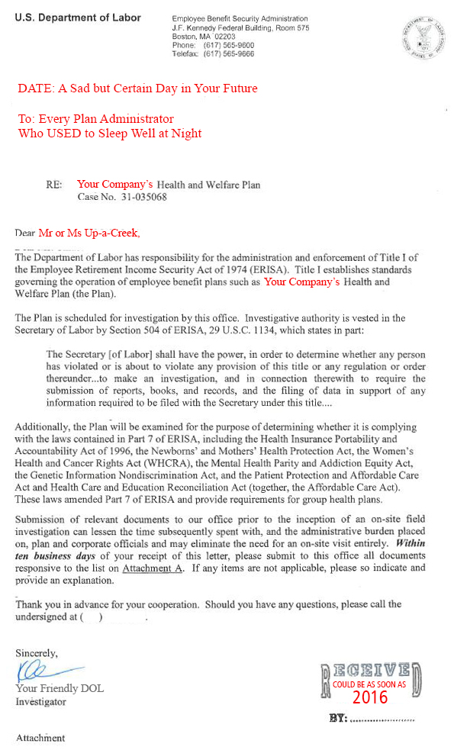

Slide 59
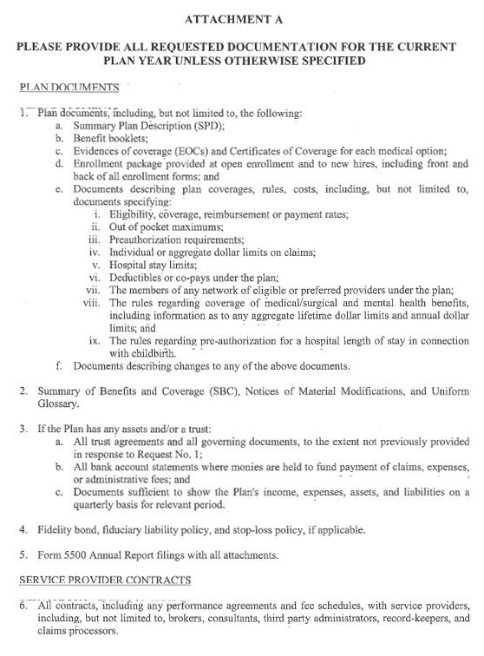

Slide 60
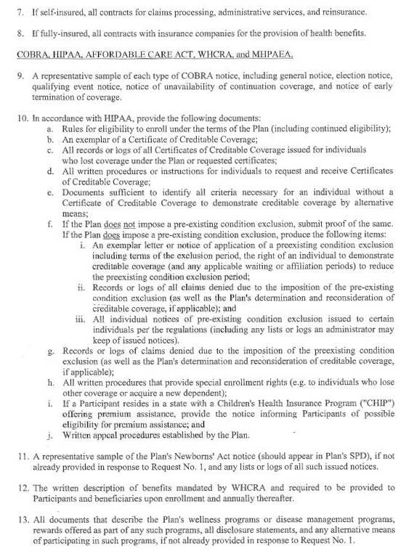

Slide 61
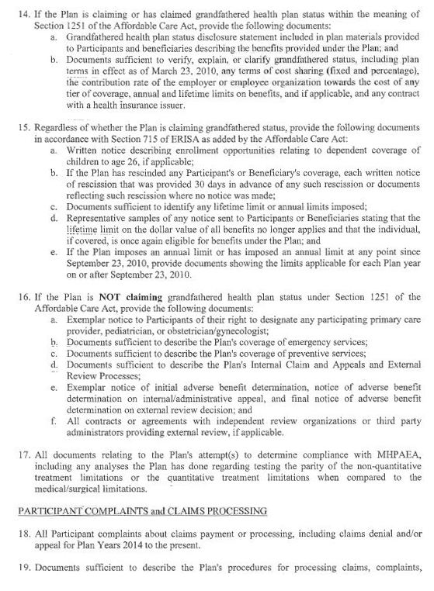

Slide 62
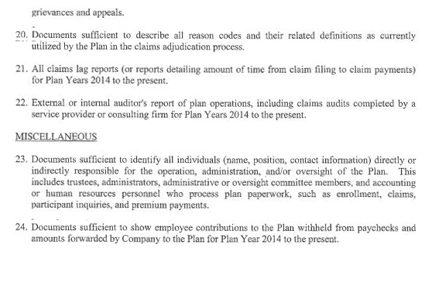

Slide 63
What Can I Expect?

Slide 64
The Process
The Process (typically) starts when agency sends letter to plan sponsor:
Advising sponsor that “plan” is to be reviewed
If retirement plan, it will be focused on one
If welfare plan, could be just health or could be all
Advising sponsor that agency will visit company on a certain date to review plan documentation

Slide 65
The Process
Advising sponsor that on-site visit obviated if sponsor will provide to agency specified documentation
Including a multitude of requests for documentation and information
Establishing a very short time frame in which to respond 5 to 7 days!

Slide 66
Plan Documentation Requirements

Slide 67
Document Retention
Basic Rule: employee benefit plan documents and documents required by ERISA must be retained for six to eight years after the date of filing, resolution, or amendment
Materials should be preserved in a manner and format that permits ready retrieval
All records including annual reports, disclosures, amendments and resolutions should be retained

Slide 68
Document Retention
This includes:
Original signed plan documents and amendments
Corporate resolutions and Board minutes
committee meeting minutes related to the plan
Plan disclosures and communications to participants--Form 5500s, SARs, SPDs, SMMs, etc.
Financial reports, audits, and related statements
Trust documents

Slide 69
Document Retention
Nondiscrimination and coverage testing results
Disputed claim records in the event of future litigation
Payroll and census data used to determine eligibility and contributions
Notices of Creditable/Non-creditable coverage
Did you file with CMS on-line
IRO Contracts (Need for HRA plans too!!)

Slide 70
Common Misconception
Agencies only look back three years—NOT TRUE
It is a good internal practice for the official plan documents to be retained for the life of the plan, so that the plan sponsor has a paper trail of the plan from its inception.
You may need to prove it under ACA!

Slide 71
Electronic Delivery

Slide 72
It’s Not For Everyone
The basics:
Delivery steps taken for furnishing documents are reasonably calculated to result in the actual receipt of the documents
Using return-receipt or notice of undelivered e-mail features
Conducting periodic reviews or surveys to confirm receipt
Reasonable and appropriate steps taken to safeguard confidentiality of personal information related to accounts and benefits

Slide 73
It’s Not For Everyone
Electronically delivered documents are prepared/furnished in a manner consistent with the style, format and content requirements applicable to the document
A paper version of the electronic document must be available on request (at no charge)
Each time an electronic document is furnished, a notice (electronic or paper) must be provided to each recipient describing the significance of the document

Slide 74
ACA—A New Addition to the DOL’s Toolkit

Slide 75
How you respond makes a BIG difference to the outcome!

Slide 76
Grandfathered Status
For plans that are claiming or have claimed grandfathered status, DOL asks for:
disclosure statements regarding grandfathered status included in material distributed to participants and beneficiaries describing the benefits provided under the plan; and
records documenting the terms of the plan on March 23, 2010, along with any ancillary documents required to verify the status of the grandfathered plan; and
provision in SPD that excludes children under 26 with other employer coverage and records for documentation.

Slide 77
Non-Grandfathered Status
Requests applicable to non-grandfathered plans:
The plan’s choice provider disclosure notice, along with a list of participants who received that notice;
Documents relating to the plan’s emergencies services benefits;
Documents relating to the preventative services for each plan year on or after September 23, 2010;

Slide 78
Non-Grandfathered Status
The plan’s internal claims and appeals procedures;
Notices relating to adverse benefit determinations, the plan’s final internal adverse determination notice, and the plan’s final external review determination notice; and
Contracts or agreements with independent review organizations or third party administrators providing external review.

Slide 79
Requests applicable to all plans:
For plans with dependent care coverage, a sample of the notice describing enrollment opportunities relating to coverage of children up to age 26;
A list of the any participants who had coverage rescinded and the reason for such rescission;
If the plan imposes or has imposed a lifetime limit since September 23, 2010, documents relating to that limit for each plan year; and
If the plan has imposed an annual limit since September 23, 2010, documents relating to that limit.

Slide 80
HIPAA

Slide 81
Portability
Extensive & Focused Audit Activity on Portability
Certificate of Creditable Coverage – must be provided: (Gone as of 12/31/2014)
Provide notice of special enrollment rights
Provide preexisting condition notice – must include: (Gone as of 12/31/2014)

Slide 82
HIPAA Privacy & Security
Privacy Standards Compliance Checklist
Determine whether any state privacy laws apply to the group health plan
Identify group health plan’s current uses and disclosures of protected health information, including the individuals who have access to protected health information
Determine which current uses and disclosures are permitted and under what circumstances
Privacy Notice furnished to new hires and again for any changes in contacts. Got the Proof?

Slide 83
HIPAA Privacy & Security
Determine whether group health plan documents need to be amended in order to (or continue to) receive protected health information for plan administrative purposes
Identify service providers who are business associates
Determine whether business associate service provider contracts need to be amended to comply with privacy rules
Check your BA’s!

Slide 84
Privacy & Security
Security Standards Compliance Checklist
New HITECH Rules for Privacy & Encryption
New Penalty Structure
Increased enforcement
IT Manager should be familiar with HIPAA Security Standards and be able to demonstrate compliance
Notes:
84

Slide 85
Cafeteria Plans
Increased Audit Activity?
Expected because IRS released regulations in 2007
Plan Documentation Issues Are Big Issue. You may have an FSA SPD but does it include Premium Only language?
Non-Discrimination Testing Big Focus
All components of the cafeteria plan must be tested annually
Keep documentation for six years
WAITING…………Final regulations to match 105(h)

Slide 86
DOL Audit Questions

Slide 87
Proof Essential!
Audit Request:
Documents stating the eligibility criteria for enrolling in the Plan
What to provide:
Copy of SPD eligibility definitions
Copy of any prior SMM’s as applicable (change in waiting period for example from 180 days to FOMA 60)
Copy of Employee Open Enrollment Handbook or Hand outs.
*Look Back Amendment or Addendum to SPD for ACA eligibility!

Slide 89
Actual Questions
A copy of the plan’s general notice of preexisting condition issues to enrollees (including any lists or logs an administrator may keep of issues notices), or proof that the plan does not impose a preexisting condition exclusion. Audit may go back to plan years with pre-existing conditions, will be required to provide proof
The Plan’s Notice of Special Enrollment Rights (distributed to employees on or before the time they are offered the opportunity to enroll in the Plan)
The plan’s “Newborns’ Act” notice, including lists or logs of notices an administrator may keep of issues notices
Materials describing evidence of compliance with the Genetic Information Nondiscrimination Act (“GINA”) that includes GINA’s prohibition against group-based discrimination based on genetic information and the limitation on requesting or requiring genetic testing

Slide 90
Actual Questions
Documentation demonstrating compliance with Michelle’s Law and the notice requirement
Documentation evidencing that the Plan provided notices describing the benefits required under the WHCRA to participants and beneficiaries upon enrollment in the Plan and annually thereafter
SPD at time of hire and annual notice at open enrollment – what’s that look like to a DOL Auditor?

Slide 91
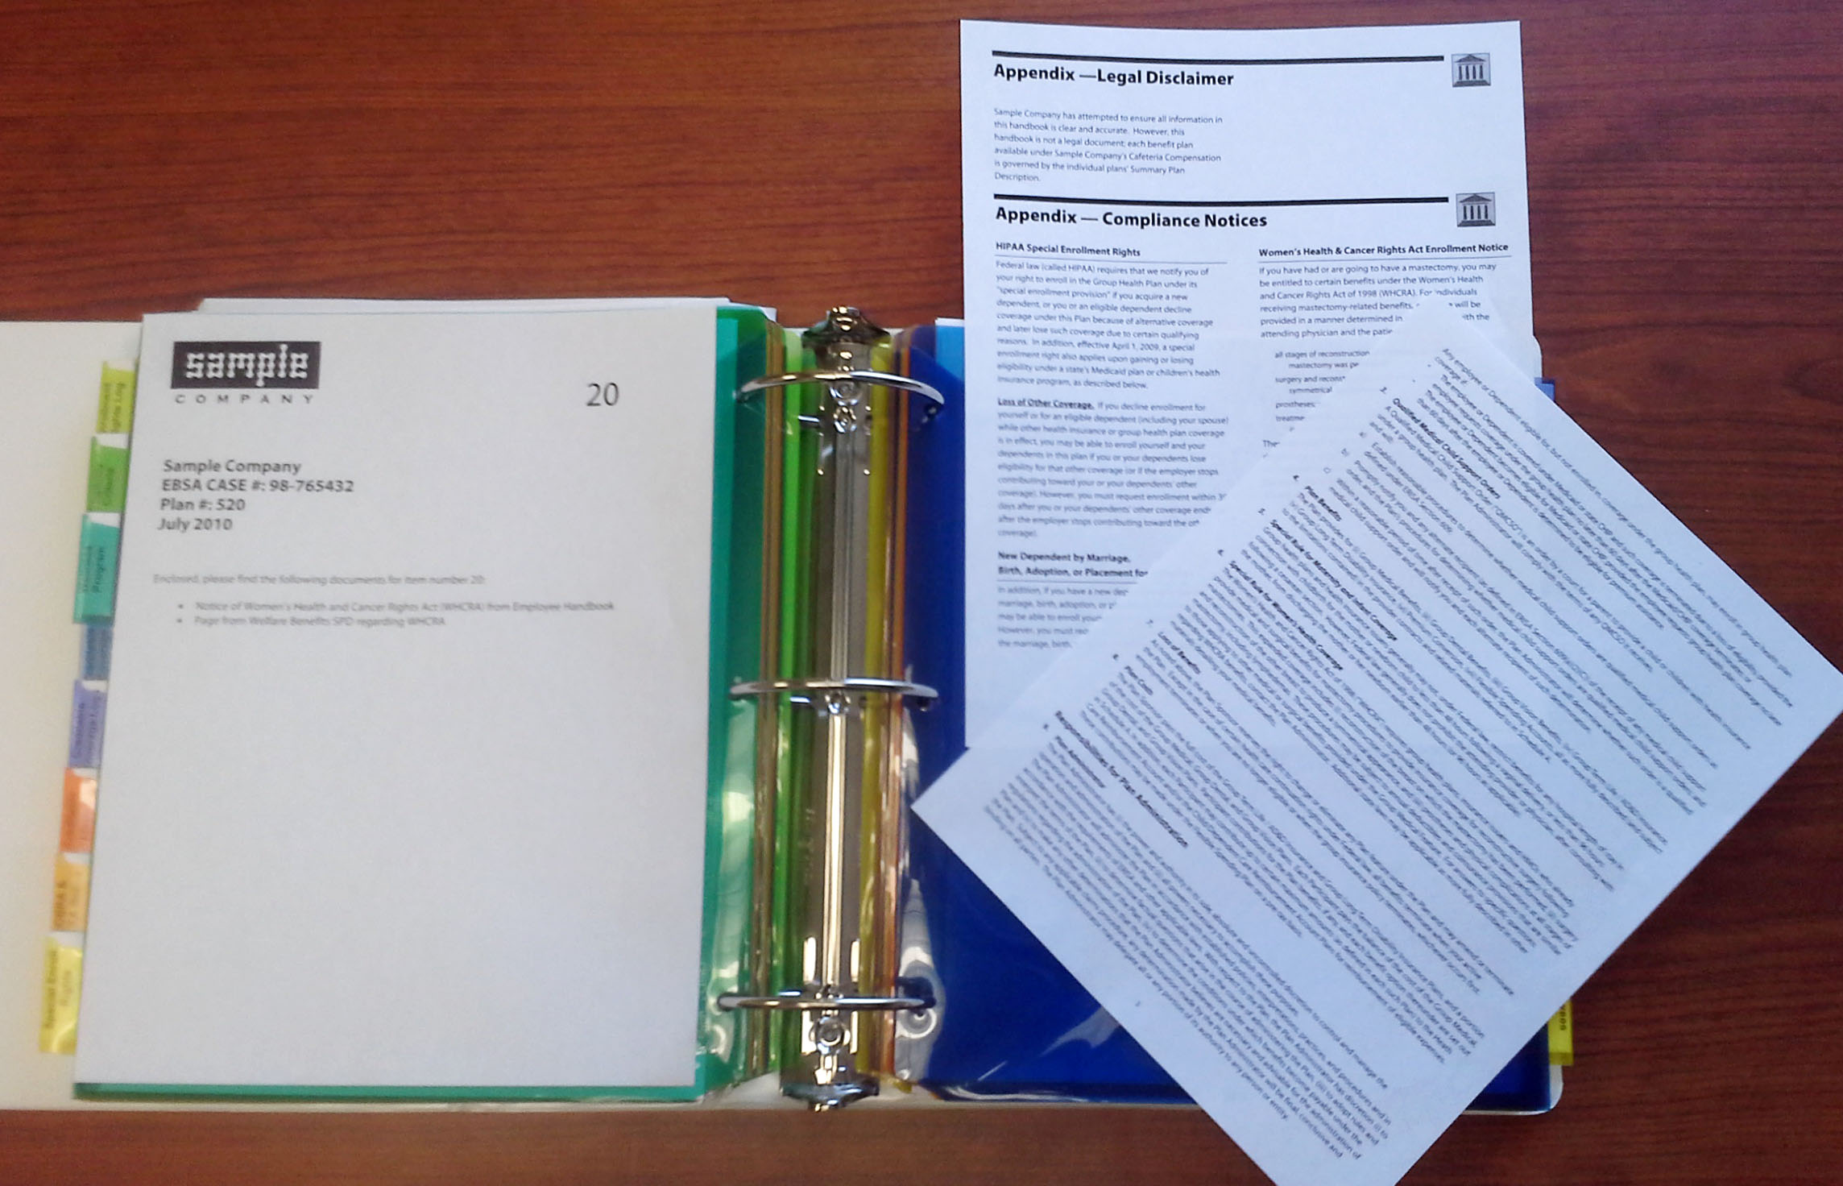

Slide 92
Actual Questions
A sample COBRA and ARRA* Notice for the Plan
*The audit can go back as far as ARRA, everyone remember how much fun that was!
Sample Certificate of Creditable Coverage
Documentation provided to participants and beneficiaries in the Plan that sets forth the procedure by which they may request and receive Certificate of Creditable Coverage

Slide 93
Actual Questions
Minutes of any meetings related to the Plan from January 1, 2009 to the present
The name, title, address and telephone number for the contact person for the Plan Administrator (i.e. the person at the employer/plan sponsor responsible for the day to day activities related to the Plan)
Plan Documents for each benefit offered under the Plan (i.e. medical, dental, etc.) with all amendments (these documents should provide detailed descriptions of all the benefits and services offered under the Plan as well as explain the restrictions and the costs to participants)
Summary Plan Descriptions (SPDs)

Slide 94
Actual Questions
Form 5500, 5500-C, or 5500-R, Annual Return Report of employee Benefit Plan for 2008 to the present together with attachments
Summary Annual Reports for 2009 and 2008
Fidelity Bond (i.e., declaration page and all riders and endorsements)
All documents related to any Wellness Programs or Disease Management Programs offered under the Plan

Slide 95
What Happens Next?
The U.S. Department of Labor will release it’s findings at the conclusion of the investigation.
The DOL report will provide specific provisions of ERISA believed to have been violated and will provide regulations to support their finding of a failure.
The report will also review what was actually missing/incomplete with details of the failure and what they WANT to see.
Finally, actions that the Department has determine to take – this is where you hold your breathe for those words……………………
The Department will not take any further action with respect to this matter

Slide 96
Court Cases, Awards and DOL Fines (related to Welfare Benefit Plans that were not in compliance with ERISA laws)
Awards & DOL fines | Court Case
$4,540 - Employer indifference and irresponsibility led to disclosure violations | Estate of Fields v. Provident Life & Accident Ins. Co., 26 EBC 2401 E.D. Pa. 2001)
$11,550 - Failure to provide SPD after written notice | Neuma, Inc. v. AMP, Inc., 27 EBC 1983 (N.D. Ill. 2002)
$13,750 - Failure to provide SPD upon written request. Maximum penalty for employer's unresponsiveness and lack of excuse. $110/day for 125 days. | James Killian vs. Concert Health Plan, et. al., Case 07 C 4755
$17,475 - Employer did not have SPD; only provided certificate of insurance to Participant; repeatedly insisted they were the same thing | Pisek v. Kindred Healthcare, Inc. Disability Ins. Plan, 2007 WL 2068326 (S.D. Ind. 2007)
$17,550 - Failure to provide requested Plan Document and SPD to Participant | Reddy v. Schellhorn, 38 EBC 1312 (N.D. Ill 2006)

Slide 97
Court Cases, Awards and DOL Fines
Awards & DOL fines | Court Case
$10,560 - Late delivery of SPD to employee after 3 written requests, max. penalty $110/day | Kasireddy v. Bank of America Corp. Benefits Committee, 2010WL 4168512 (N.D. Ill. Oct. 13, 2010)
$11,550 - Failure to provide SPD after written notice | Brown v. Aventis Pharmaceuticals, Inc., U.S. Court of Appeals, Eighth Circuit, No. 02-4063/03-2084, Sept. 9, 2003
$13,750 - Failure to provide SPD upon written request. Maximum penalty for employer's unresponsiveness and lack of excuse. $110/day for 125 days. | Latimer v. Wash. Gas Light Co., 2012 WL 2119254 (E.D. Va. 2012)
$17,475 - Employer did not have SPD; only provided certificate of insurance to Participant; repeatedly insisted they were the same thing | Sunderlin v. First Reliance Std. Life Ins. Co., 235 F. Supp. 2d 222, 29 EBC 2227 (W.D.N.Y. 2002)
$17,550 - Failure to provide requested Plan Document and SPD to Participant | Stegelmeier v. Doug Andrus Distributing Employee Health Benefit Plan, 40 EBC 2811 (D. Utah 2007)

Slide 98
Court Cases, Awards and DOL Fines
Awards & DOL fines | Court Case
$18,400 - Failure to deliver SPD on request; $25 x 736 days; without prejudice or bad faith | Mullins v. AT&T Corporation, Nos. 04-2135, 04-2136, 07-1717, 10-2010 (4th Cir. 2011 ) (Unpublished Opinion)
$26,100 - Failure to respond to document request over very long time | Daniels v. Thomas & Betts Corp., 263 F3d 26 EBC 2132 (3rd Cir. 2001)
$32,850 - Delay, indifference, disregard in failure to provide copy of requested Plan Document to Participant | Lampkins v. Golden, 1996 WL 729136 (6th Cir. 1996) (collecting cases from 1st, 3rd, 4th, 6th, 10th, and 11th Circuits)
$34,540 - Failure to provide participation agreement between employer and LTD carrier prejudiced Participant's ability to establish enrollment date | Logan v. Unicare Life & Health Ins., Inc., 2007 WL 1875943 (E.D. Mich. 2007)
$37,650 - Requested documents provided at widely spaced intervals | Hemphill v. Pers. Rep. of Estate of Ryskamp, 2008 WL 789894, as modified, 2008 WL 1696722 (E.D. Cal. 2008)

Slide 99
Court Cases, Awards and DOL Fines
Awards & DOL fines | Court Case
$50,000 - Failure to file Form 5500 | PWBA v. Compgraphix, Inc., 199-RIS-52 (ALJ Oct. 14, 1999)
$55,760 - Incompetence and neglect delivering insurance contracts to Participants | Amschwand v. Spherion Corp., 37 EBC 1842 (S.D. Tex. 2006)
$62,250 - Failure to deliver SPD to Participant in manner required by DOL | Leyda v. AlliedSignal, Inc. 322 F.3d 199 (2d Cir. 2003)
$64,900 - Provided SPD, but failed to provide requested full Plan Document | Keogan vs. Towers, Perrin, Forster & Crosby, Inc., 30 EBC 2641 (D. Minn 2003)
$86,500 - Failure to file complete and accurate Form 5500 | Airport Hospitality, LTD, King of Prussia, Penn., 2010
$105,840 - Plaintiff's attorney's fees in LTD claim case; award unknown | Hemphill v. Pers. Rep. of Estate of Ryskamp, 2008 WL 789894, as modified, 2008 WL 1696722 (E.D. Cal. 2008)

Slide 100
Court Cases, Awards and DOL Fines
Awards & DOL fines | Court Case
$159,000 - Late entrant; employer gave employee wrong waiting period & ordered to pay claim | PWBA v. Compgraphix, Inc., 199-RIS-52 (ALJ Oct. 14, 1999)
$241,000 - Failure to provide SPD to Participant | Amschwand v. Spherion Corp., 37 EBC 1842 (S.D. Tex. 2006)
$5,000,000 - Cancer treatment claim wrongfully denied as experimental. State court jury trial, punitive damages | Leyda v. AlliedSignal, Inc. 322 F.3d 199 (2d Cir. 2003)
$8,692,000 - Bad faith claim denial. Punitive damages. State court jury trial | Keogan vs. Towers, Perrin, Forster & Crosby, Inc., 30 EBC 2641 (D. Minn 2003)
10 Months Prison - Plus $46,844 fine; failure to file 5500; diverting employee contributions | Airport Hospitality, LTD, King of Prussia, Penn., 2010
Award N/A – Court reversed Administrator’s decision to terminate disability payments based on a de novo review of the facts. | Lundquist v. Continental Casualty Company, No.CV 02-9602-FMO, United States District Court, Central District of California, Sept 30, 2005.

Slide 101
Thank You!
Lisa C. Allen, CHRS, CAS, CFC Vice President, Regulatory Affairs
LALLEN@RELPHBENEFITADVISORS.COM Office: 1-800-836-0026 X230 Mobile: 585-415-0448

